Slide 1
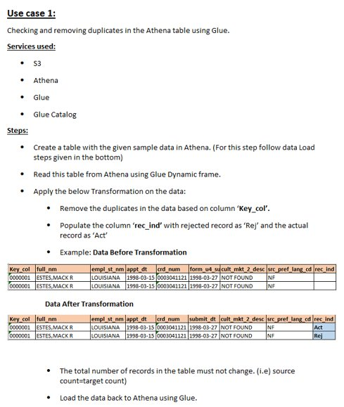
Sample Use Case For Practice

Slide 2
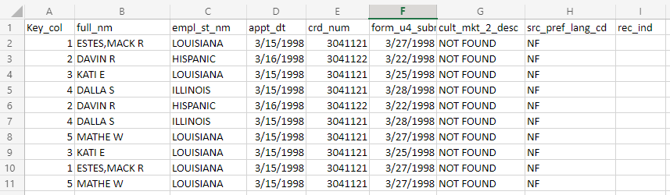
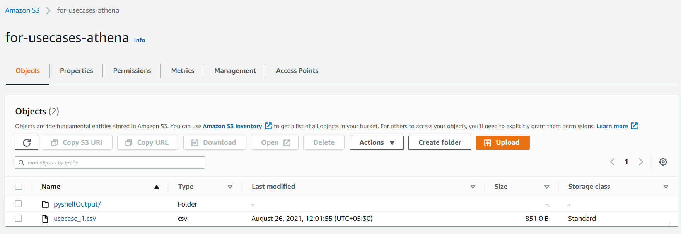
Amazon S3
usecase_1.csv
Create a bucket (Make it as Public)
Upload a csv file to this bucket (usecase_1.csv)
Create a folder for storing output

Slide 3
AWS Glue
AWS Glue --> Crawlers --> Add crawler --> choose usecase1.csv file path in S3 --> set database name --> finish --> run
Database & tables are created, while perform above step
ETL – Jobs -->Add job --> security configuration (worker type = standard, Number of workers = 2, job timeout = 10 ) -->save and edit script
Use Script as Python Shell
Give a permission to access S3

Slide 4
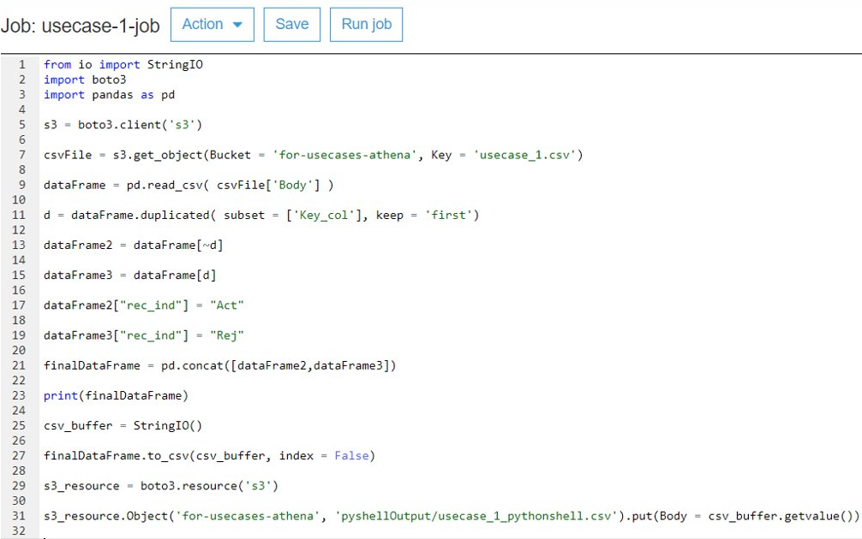
Python Shell code
Once completed the code, then Save and run job
Can see the output csv file in S3
< code line : 31 >
Can also see the output in CloudWatch
Code Error
/aws-glue/python-jobs/error
Code Run Successfully
/aws-glue/python-jobs/output

Slide 5
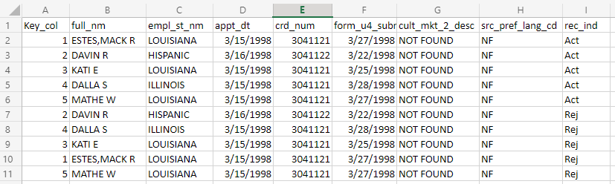
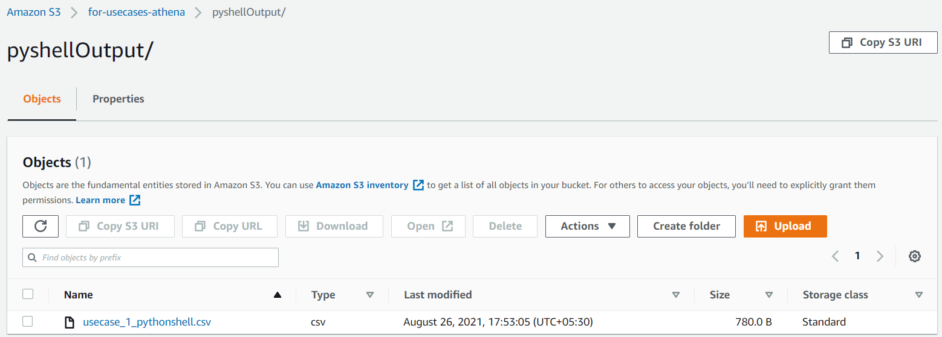
Amazon S3
usecase_1_pythonshell.csv
Output file stored

